Slide 1
Linear Model
CSLT ML Summer Seminar (2)
Dong Wang

Slide 2
Content
Linear regression
Logistic regression
Linear Gaussian
Bayesian model and regularization

Slide 3
Why linear model?
Easy in model training
Fast in inference
Robustness

Slide 4
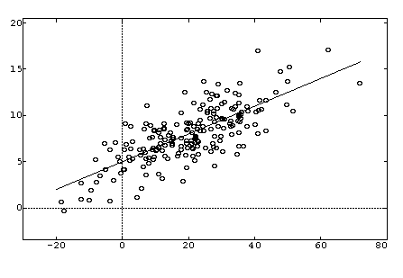
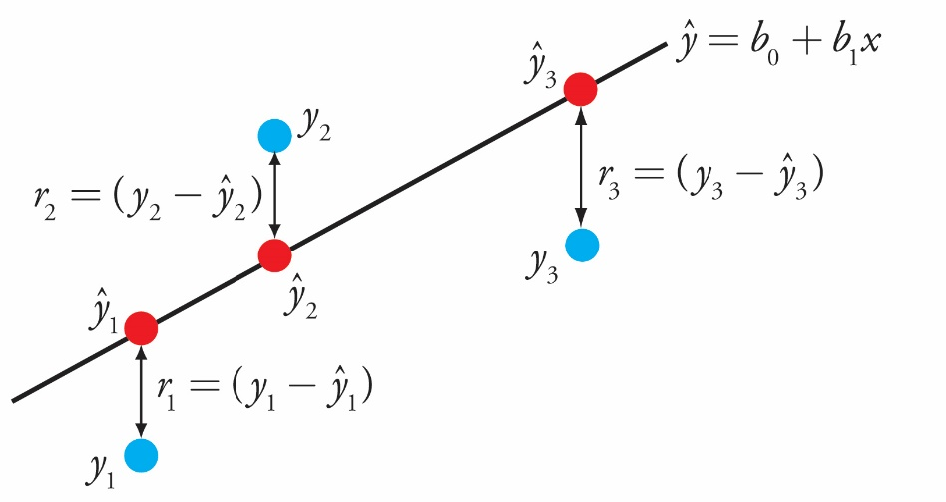
Start from polynomial fitting
Task: Given training data {<xi,yi>}, predict y for a given x.
Model structure: linear interpolation
Training objective:
Training approach: close-form solution or numerical solution
Inference approach: multiplication and sum
Formulated as polynomial fitting.

Slide 5
Move to a probabilistic framework
The essential difficiulty of ML tasks resides in uncertainty
  Uncertainty in underlying force/mechanism/corruption
  Probabilistic model address the uncertainty by high-level assumption (distribution)
We prefer a probabilistic interpretation
  Unified understanding
  Unified design
  Unified optimization
  Unified generalization(extension, modification, etc..)

Slide 6
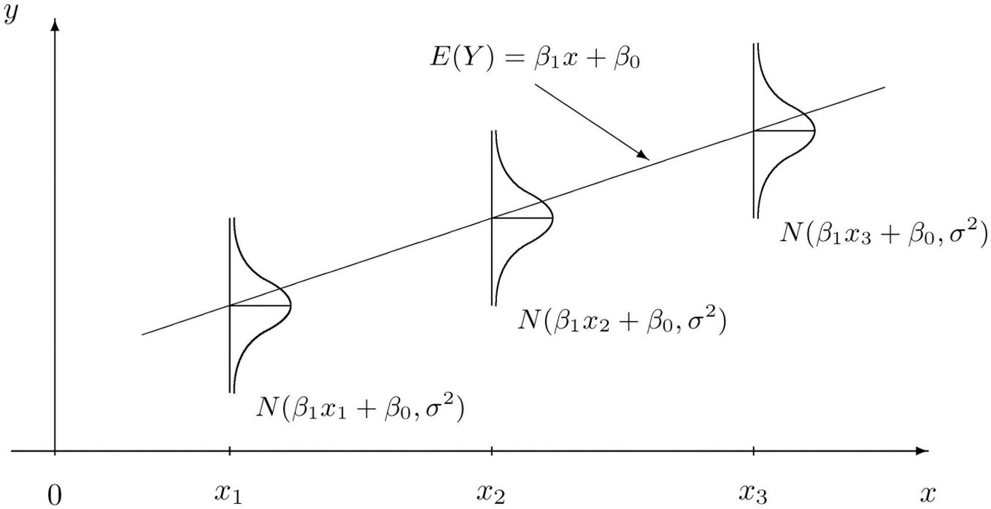
From polynomial fitting to linear regression
Assume linear predictive model with respect to the parameter w.
Assume Gaussian noise, which is unexplained residual for the data
Prediction becomes probabilistic!
Note that complex feature transform does not change the linearity
Maximum likelihood prediction

Slide 7
Maximum likelihood training
Train parameters to maiximize the probability of the training data.
Mean sequare error (MSE)!

Slide 8
Think one minute before going forward
We assume a Gaussian distribution on the noise, obtain the polynomial fit.
A strong support why use MSE
How about if we use other noises?
Alternative assumptions on the parameters and noises lead to different and related models, with cost functions that it is not easy to find any correlation among them.

Slide 9
Now train the model

Slide 10
Logistic regression: a bernoli noise
A binary classification task
Assume the prediction structure y=σ(wx)
Assume Bernoli distribution on the target t with parameter y.
The same as in linear regression!

Slide 11
Softmax regression: a multinomial noise
A multi-classification task
Assume the prediction structure y=σ(wx), where σ() is a softmax
Assume multinomial distribution on the target t with parameter y.
Cross entropy

Slide 12
Probit regression: a probit noise
Assume a more implict noise derived from a cumulative distribution function.

Slide 13
If the assumption is wrong
Bishop PRML, Fig 4.4. Magenta line is linear regression, green is logistic regression

Slide 14
Extension to hierarchical structure
Static model
  Y=m+wX+ϵ
  Y=m+wU+vV + ϵ
  Y(i,j)=m+w(i)U + v(i,j)V + ϵ(i,j)
  Y(i,j)=m+U(w(i) + v(i,j)) + ϵ(i,j)
Dynamic model
  X(t)=Ax(t-1)+ ϵ; y(t)=Bx(t)+v
  X(t)=Ax(t-1)+ ϵ(t); y(t)=Bx(t)+v(t), {ϵ(t)} {v(t)} are Gaussian process

Slide 15
Probabilistic PCA
Traditional PCA find a orthogonal transform that map data to lower dimensional space, by preserving as much as the variance or minimizing the reconstruction cost.
{x_{i}}, i=1,..N, x_{i} ∈R^{D}, V= {v_{i}} ∈R^{MXD},
{y_{i}}, i=1,..N, y_{i}=Vx_{i} ∈R^{M}
The goal is to find a V so that {y_{i}} posses the maximal variation. V is called a loading matrix.
Begin with the first basis v₁, let v₁^{T}v₁ = 1, compute the variance of the projection.

Slide 16
Probabilistic PCA
v₁ is an eigen vector.λ₁is the corresponding eigenvalue.

Slide 17
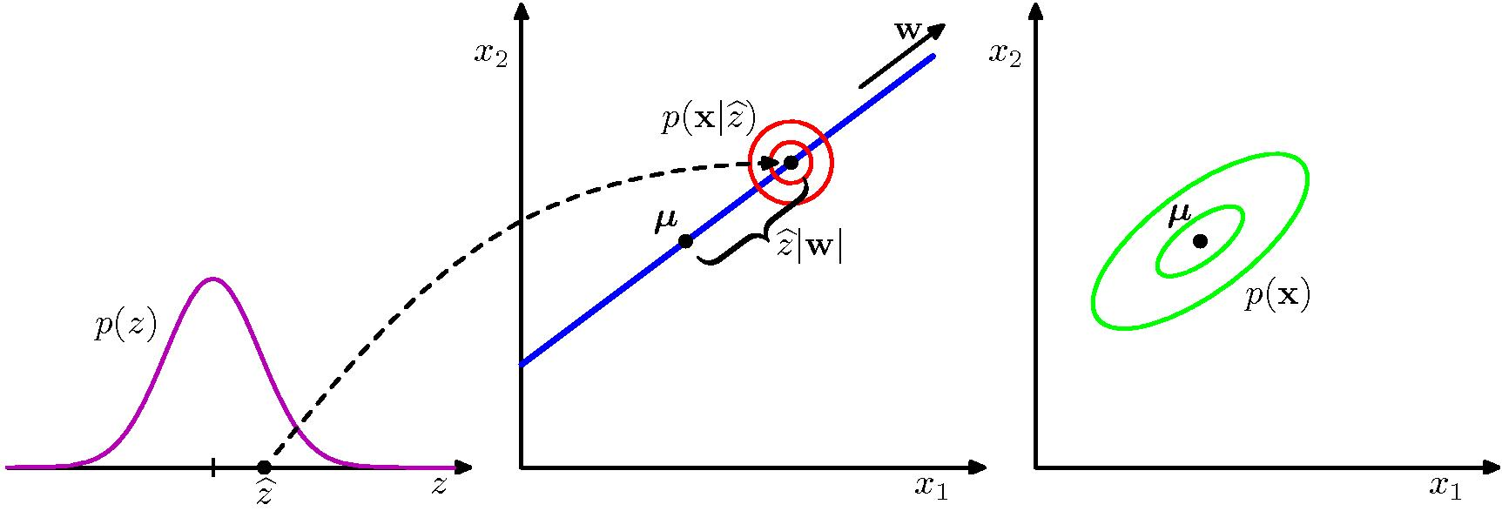
Probabilistic PCA
x = Wz + μ + ϵ ; z: N(z|0,I), ϵ: N(z|0, σ² I)

Slide 18
Probabilistic PCA
The task is: given the training data set {x_{i}}, estimate the parameters W, μ,σ.
P(z) and p(x|z) are both Gaussians, this leads to p(x) being Gaussian as well.
Note there is redundancy in W. WW^{T} is invariance with any orthogonal transform R

Slide 19
Probabilistic PCA
Estimate W,μ,σ,by maximum likelihood(ML).
Set derivatives to 0 with respect to W, μ, σ, obtain:
U_{ML}in R^{DxM}, is composed by any subset of M eigen vectors of covariance S. L is a MxM diagonal matrix, involving corresponding eigen values. R is an arbitrary orthogonal matrix.

Slide 20
Probabilistic PCA
Posterior probability p(z|x).
Projection of x is implemented as:
If σ→0, we recover the standard PCA.

Slide 21
Probabilistic LDA
Traditional LDA seeks a linear transformation y=w^{T}x, y ϵ R
such that the separation of the projection {y_{i}} between the two groups is maximized
The separation is measured by Fisher discriminant

Slide 22
Probabilistic LDA
W is an eigen vector of S_{W}⁻¹S_{B}!

Slide 23
Probabilistic LDA
X(i,j)=m+A(v(i)+ ϵ(i,j)) v: N(0,ψ), ϵ: N(0,I)
Note that sample a single v for each people in data generation

Slide 24
Training PLDA
Sample a single v for each people in model training.

Slide 25
Other famous linear Gaussian models
ICA
NMF
factor analysis

Slide 26
Other famous (pesudo) linear (non-gaussian) models
Word2vect
RBM
Max entropy
Perceptron

Slide 27
Bayesian treatment
Introduce prior on parameters to estimate
A way of integrate knowledge and experience
The estimation for parameters will be not point wise, but a distribution
The prediction is a distribution as well (not calculating the target noise)
MAP

Slide 28
A more specific case
Set a simple Gaussian prior on W
It is a conjugate prior that ensure the posterior has the same for as the prior.
Regularization!

Slide 30
PRML, fig.3.7

Slide 31
Bayesian step 1: From MLE to MAP
The maximum a posterior (MAP) can be obtained by maximizing the likelihood function with respect w:
P(w|x)∝P(x|w)P(w)
This is different from the MLE estimation P(x|w), which does not consider the knowledge on w.
Better generalization

Slide 32
Bayesian step 2: From point-wise prediction to marginal prediction

Slide 33
PRML, fig.3.8

Slide 34
Why we want Bayesain
It is a way of integrate knowledge.
Sometimes it is equal to impose regularization, which we know effective.
It propages more knowlege from training to test.

Slide 35
Wrap up
Linear model is a large fmaily of models, and we are particularly interested in probabilistic interpretations
Linear models are simple yet powerful. Put them in the priority when you face a problem.
Bayesian linear model is highly useful, but Bayesian is not limited to linear models.

Slide 36
Q&A

