Slide 1
Optimization
CSLT ML Summer Seminar (13)
Dong Wang

Slide 2
Introduction
Unconstrained problem
Constrained problem
Functional calculus

Slide 3
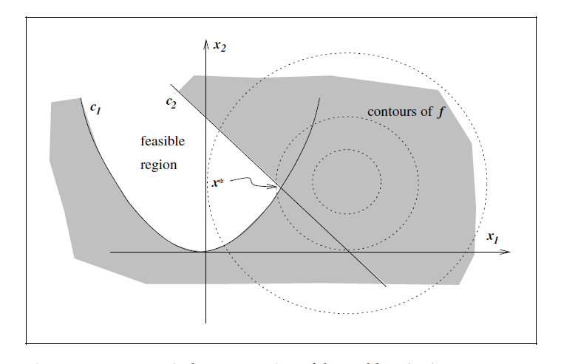
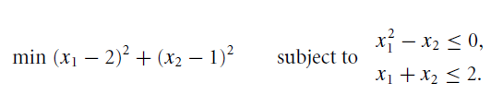
Basic concepts
Given a function f(x), our intention is to find it’s optimal point x, possibly with some constraints.
This is important for machine learning, in both model training and inference. E.g., in NN training, SVM, EM.
Note that the optimization here refers to a `pure’ optimization. That means, we have reformed the problem as a function optimization in ‘mathematical forms’.
Meta methods, e.g., sampling and evolutionary methods are not considered here.

Slide 4
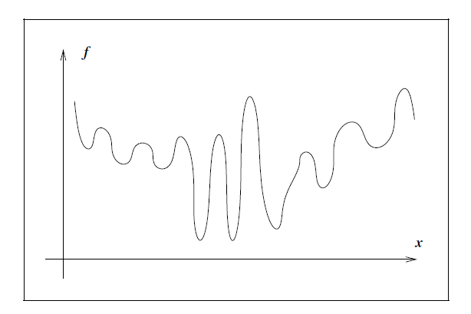
Categories
Discrete and continuous
Constrained and unconstrained
Global and local
Stochastic and deterministic
  Stochastic optimization algorithms use these quantifications of the uncertainty to produce solutions that optimize the expected performance of the model.
Convex optimization and non-convex optimization

Slide 5
Introduction
Unconstrained problem
Constrained problem
Functional calculus

Slide 6
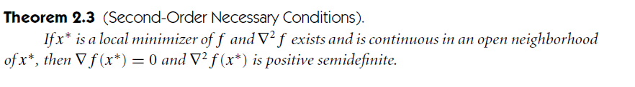
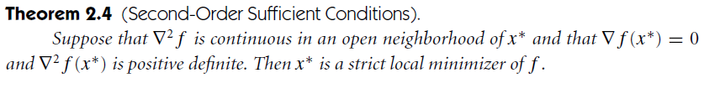
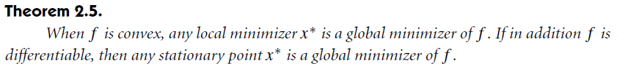
Basic theorems

Slide 7


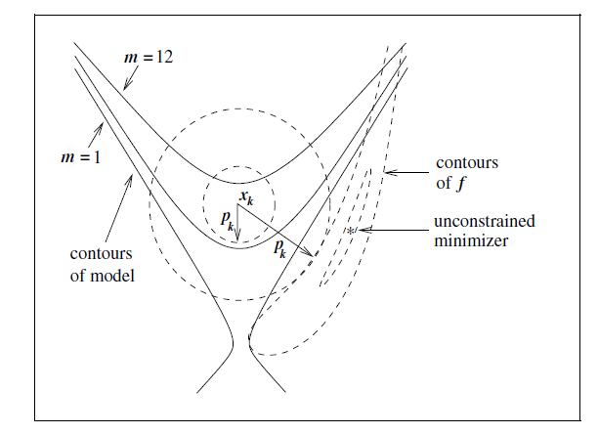

Two unconstrained optimization methods
Line search: find a direction, then move along it
Trust region: find a region that a function m_{k} can approximate f at x_{k:}
m_{k}is often defined as a Taylor

Slide 8
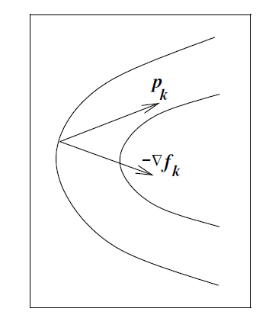


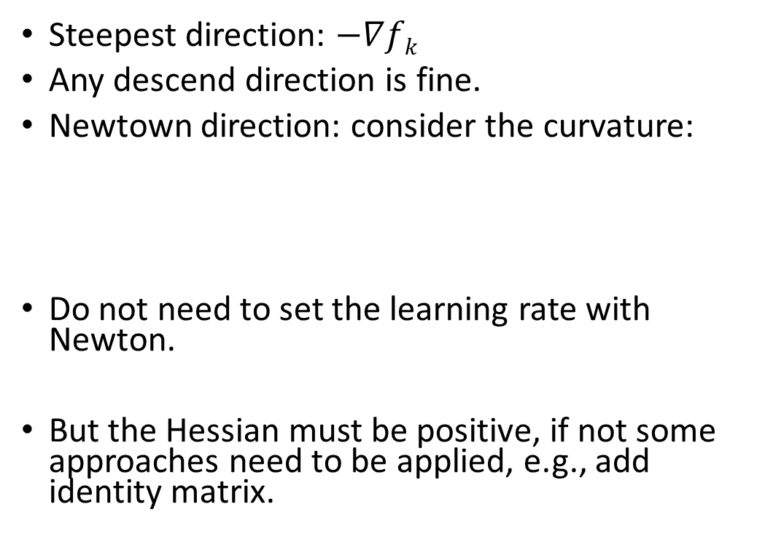
Line search: concept
Steepest direction: $−∇fk$
Any descend direction is fine.
Newtown direction: consider the curvature:
Do not need to set the learning rate with Newton.
But the Hessian must be positive, if not some approaches need to be applied, e.g., add identity matrix.

Slide 9








Quasi-Newton
Using an approximation function B_{k} for H_{k.}
Actually use the fact that the accumulated information in gradient provide some information of H.
Let (assume) the gradient of the new approximation m(p) at k+1 matches f_{k} and f_{k+1}

Slide 10



Quasi-Newton: Symmetric rank one (SR1)
Let B is symmetric (Hessian is symmetirc)
Let different between B_{k+1} and B_{k}is rank one

Slide 11
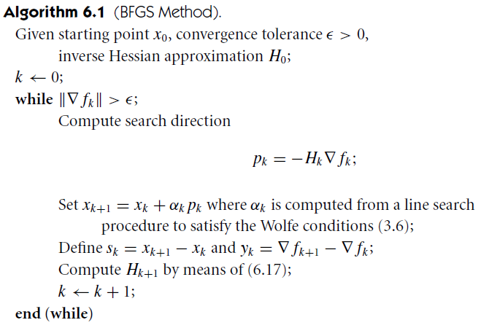


Quasi-Newton: BFGS
B_{k} is symmetric
Rank two between B_{k+1} and B_{k}
Generate positive approximation whenever B₀ is positive, and s_{k}^{T}y_{k}>0
Can use inverse Hessian

Slide 12
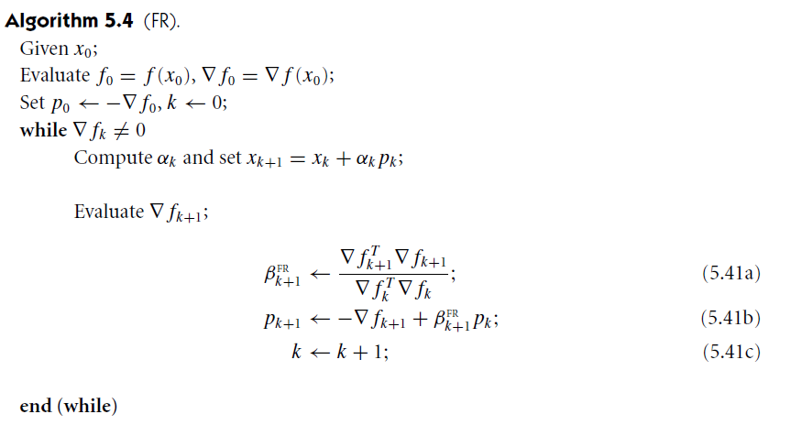


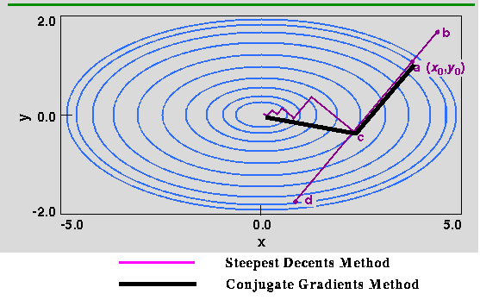
Conjugate gradient
Design a sequence of p_{k} that are conjugate. β_{k} to ensure the conjugate
Very simple to compute
Not fast than Newton or Quasi Newton, but easy and compact in memory
Preconditioning is important

Slide 13
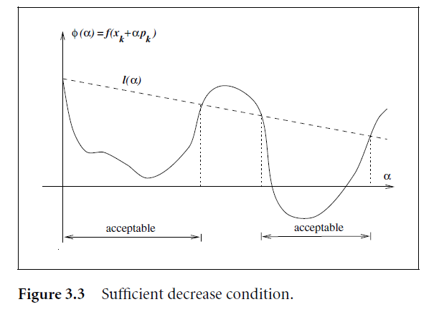
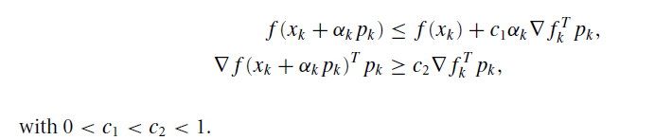
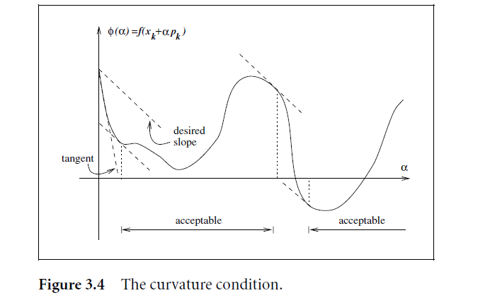
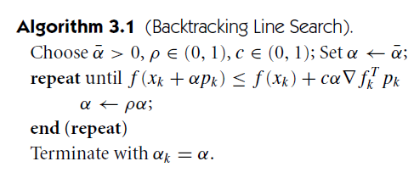
Wolf Condition

Slide 14



Trust region: concept
Define a small region where f can be approximated by its Taylor form
Again, if we know B_{k} as Hessian or its approximation, Newton or Quasi-Newton trust region methods can be obtained

Slide 15
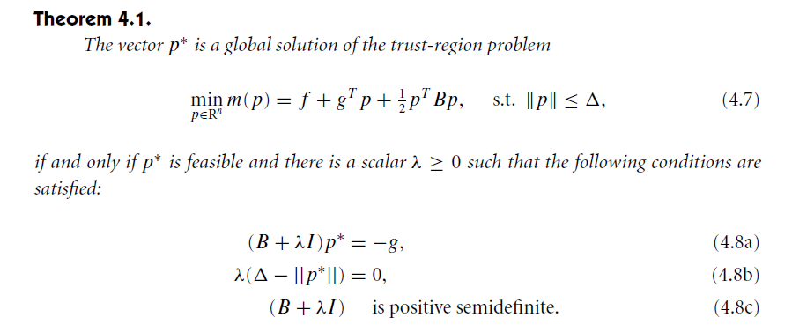
Solve the optimization problem
Find the optimal direction
Many approaches have been designed

Slide 16



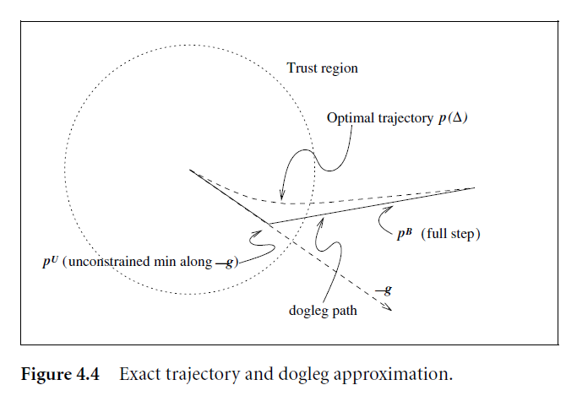

Dogleg method
The solution p(∆) is a smooth trajectory
When ∆ is very small, first order approximation is accurate
When ∆ is very large, second order approximation is accurate
Use interpolation

Slide 17
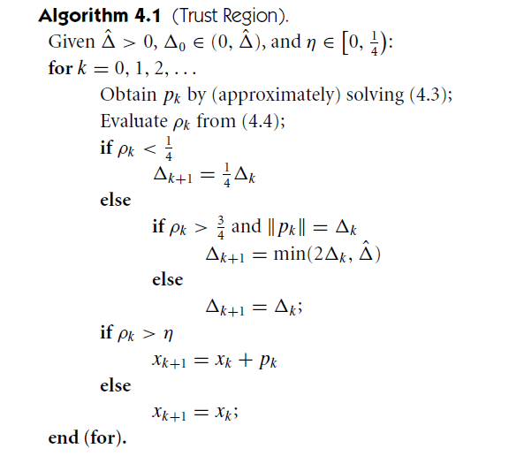

Region shrinkage
Justify if the regions is good

Slide 18
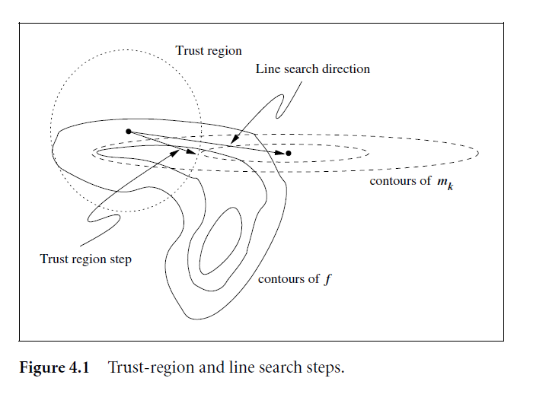
Line search and Trust region
Line search finds a direction, and then fix it and steps towards that direction. First direction, and then length.
Trust region involves an constrained optimization sub task to find a suitable direction. First length, then direction.

Slide 19
Introduction
Unconstrained problem
Constrained problem
Functional calculus

Slide 20
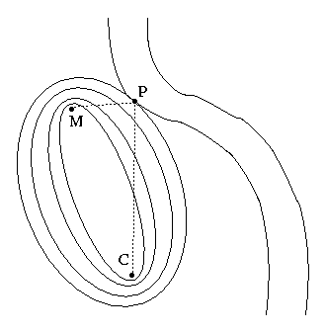

Optimization with constraints
Involve equal or unequal constraints
Usually more difficult to find the optimum

Slide 21
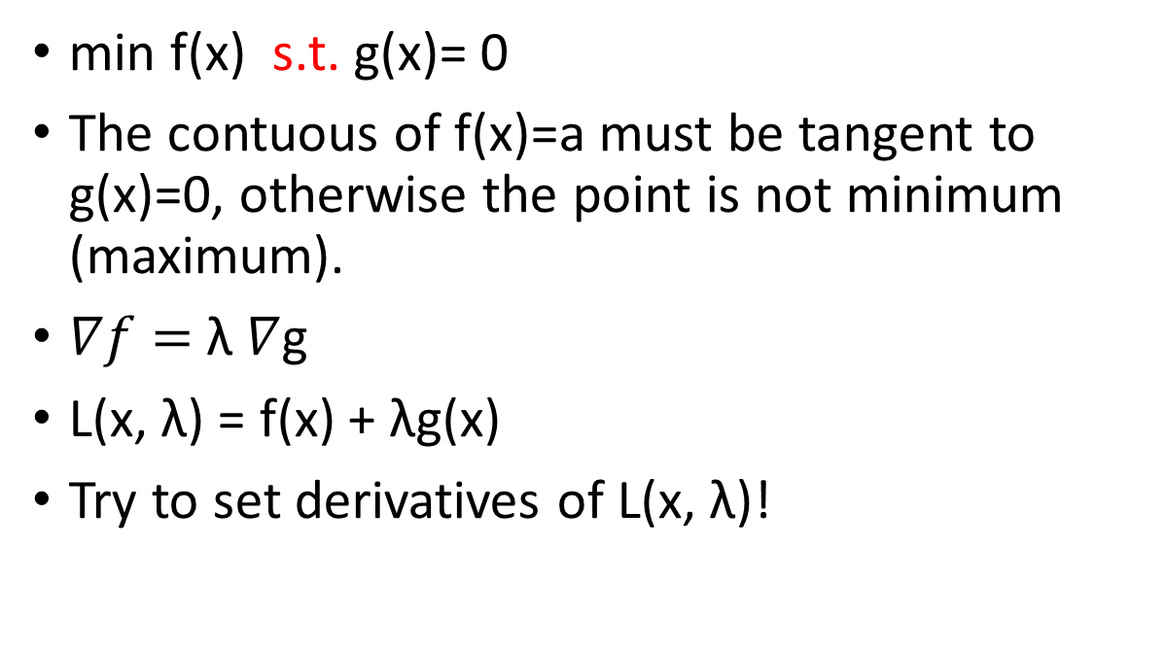
Lagrangian multiplier
min f(x) s.t. g(x)= 0
The contuous of f(x)=a must be tangent to g(x)=0, otherwise the point is not minimum (maximum).
$∇f=$λ $∇$g
L(x, λ) = f(x) + λg(x)
Try to set derivatives of L(x, λ)!

Slide 22

Lagrangian multiplier, hidden function view
We have f(x,y(x)), g(x,y(x))=0
From df/dx=0: f_{x}+f_{y}dy/dx =0;
From dg/dx=0: g_{x}+g_{y}dy/dx=0
We have f_{x}/g_{x}=f_{y}/g_{y}= λ ; so $∇f=$λ $∇$g

Slide 23
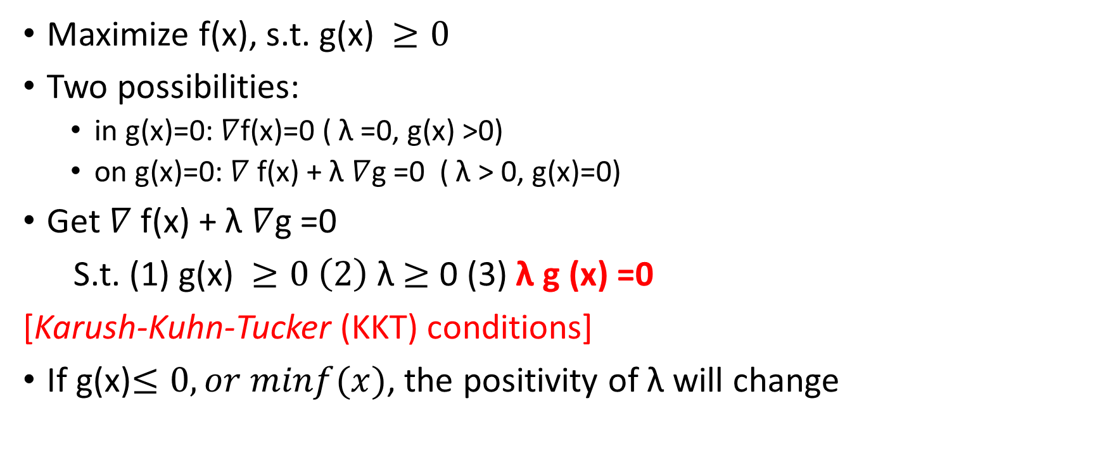
Extend to inequity
Maximize f(x), s.t. g(x) $≥0$
Two possibilities:
  in g(x)=0: $∇$f(x)=0 ( λ =0, g(x) >0)
  on g(x)=0: $∇$f(x) + λ $∇$g =0 ( λ > 0, g(x)=0)
Get $∇$f(x) + λ $∇$g =0
S.t. (1) g(x) $≥0 \left(2\right)$ λ $≥$ 0 (3) λ g (x) =0
[Karush-Kuhn-Tucker (KKT) conditions]
If g(x)$≤0, or minf(x)$, the positivity of λ will change

Slide 24
The full result
Mximize f(x) s.t.
Turn to maximize
s.t.

Slide 25



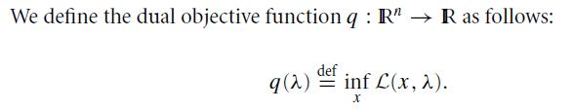




Dual problem
Compute derivatives w.r.t. x₁ and x_{2,} make them equal to 0.

Slide 26
Goodness for dual
In its full generality, duality theory ranges beyond nonlinear programming to provide important insight into the fields of convex nonsmooth optimization and even discrete optimization.
Its specialization to linear programming proved central to the development of that area.
In some cases, the dual problem is easier to solve computationally than the original problem. In other cases, the dual can be used to obtain easily a lower bound on the optimal value of the objective for the primal problem.

Slide 27
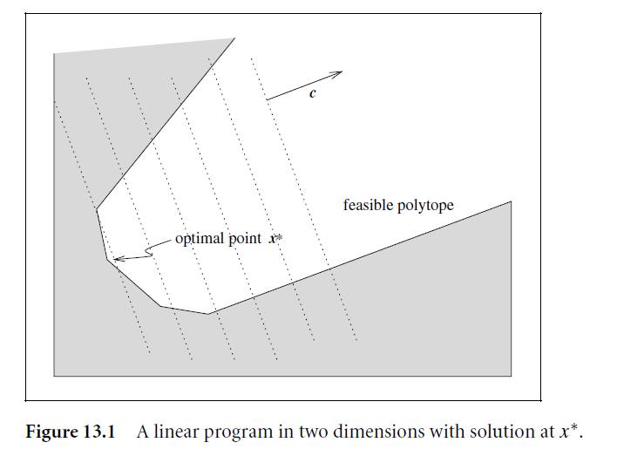



Linear programing
The objective and ALL the constraints are linear
All other forms can be transformed to this standard form

Slide 28



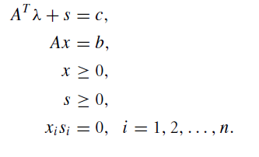



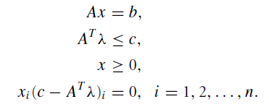

Using dual
KKT
KKT

Slide 29
Simplex method
Form a set of basic vectors
Update the basic vectors sequentially

Slide 30
Interior-point methods
Not follow the border lines, instead in the inner of the feasible area
Primal-dual interior-point method. Find the Newton direction, but modify it to ensure positive constraints

Slide 31
Quadratic programing
Can solve the KKT directly
An iterataive method, e.g., conjugate approach, that optimizes x in block-wise, can be used.

Slide 32
Augmented Lagrangian Methods
  Change the ‘hard constraint’ to a soft constraint
  Let the penalty increasing to infinite, converge to the original problem
  It is usually more easier, as the funciton becomes smooth
  Different from Lagrangian, as no additional multiplier added.

Slide 33
Sequential Quadratic Programing (SQP)
Model the problem at the current iteration x_{k}by a quadratic programming subproblem
Solve the quadartic problem and get the new x_{k+1}

Slide 34
Small summary
Unconstrained optimization
  Basic is Taylor expansion
  Linear search
    GD/SGD
    Newton
    Quasi-Newton (SR1, BFGS)
    CG
  Trust region
    Dogleg method
Constrained optimization
  Basic is Lagrangian
  Linear programming
    Primary Dual
    Simplex
    Interior point
  Quadartic programming
  Augmented Lagrangian
  SQP

Slide 35
Introduction
Unconstrained problem
Constrained problem
Functional calculus

Slide 36
Calculus
Traditional calculus is for variables
How if the variable is a function?

Slide 37

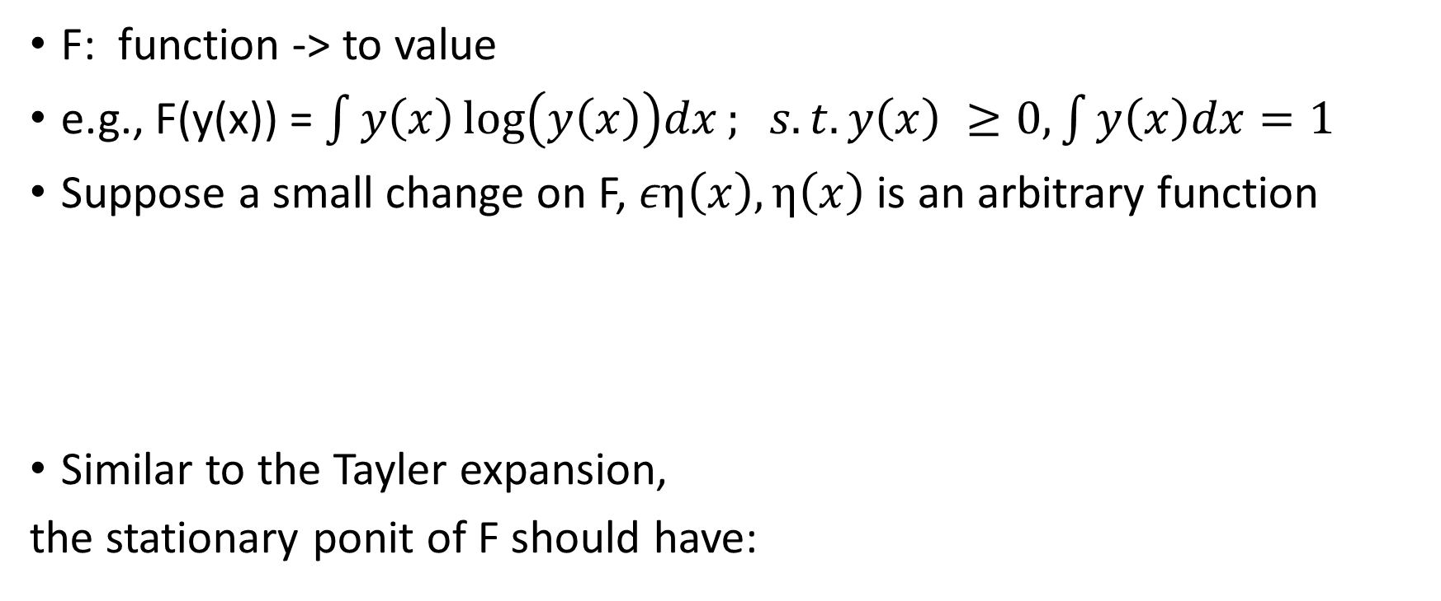
Functional
F: function -> to value
e.g., F(y(x)) = $\int{y\left(x\right)\log\left(y\left(x\right)\right)dx; s.t.y\left(x\right) ≥0, \int{y\left(x\right)dx=1}}$
Suppose a small change on F, $εη\left(x\right),η\left(x\right)$ is an arbitrary function
Similar to the Tayler expansion,
the stationary ponit of F should have:
Functional derivative of F(y) w.r.t y(x)

Slide 38

Functional
Since η(x) is arbitrary$\frac{δF}{δy(x)}=0 for all x$

Slide 39
Functional
An example

Slide 40
Functional
If we assume a distribution p(x), its mean is u, variance is σ², then the entropy is a functional: H(p)=∫plogp
Maximize H(p) s.t., ∫p(x)dx=1, ∫xp(x)dx=u, ∫x²p(x)dx=u²+ σ²
Lagrangian multiplier, the maximization problem is:
F(p, λ ₁ , λ₂ , λ₃ )
=∫plogpdx + λ ₁∫p(x)dx + λ₂ ∫xp(x)dx + λ₃∫x²p(x)dx
=∫(plogp+ λ ₁p+ λ ₂xp + λ₃x²p)dx

Slide 41

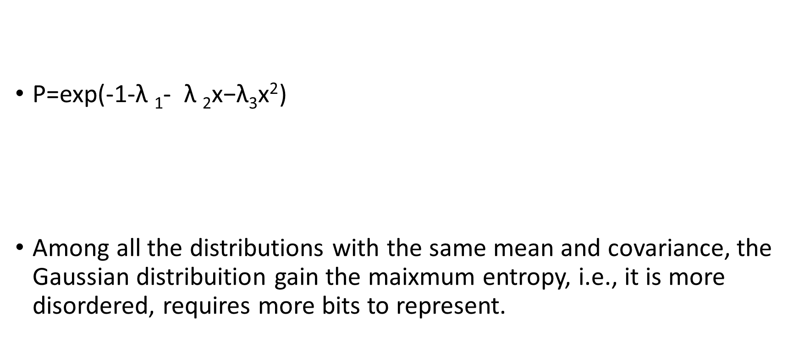
P=exp(-1-$\text{λ} \text{1}$- $\text{λ} \text{2}\text{x}\text{−}\text{λ}\text{3}\text{x}\text{2}$)
Among all the distributions with the same mean and covariance, the Gaussian distribuition gain the maixmum entropy, i.e., it is more disordered, requires more bits to represent.
$$G=plogp+\text{λ} \text{1}\text{p}\text{+} \text{λ} \text{2}\text{xp}\text{ + }\text{λ}\text{3}\text{x}\text{2}\text{p}$$
Gassian distribution!

Slide 42
Wrap up
Optimization involves numerous methods, motivated by multiple intuitions. The basic ideas involve divide and conquer, iterative, transform, nonlinear to linear, constrained to unconstrained.
Optimization can be on variables, but can be also on functions.
We didn’t touch many other, e.g., auto gradient, finite difference, genetic method, and didn’t touch many tricks, e.g., clipping. However, most problems that we often encoutered in machine learning can be solved using the methods mentioned here.
There are many open tools for almost any optimization tasks, but problem definition might be hard.

